Slide 1
Internal Security Matter: London Area Robberies
Compliance Internal Operations
Confidential Internal Documents
Confidential Interval Documents. Not for external distribution outside of the Metropolitan Police’s Special Assessment Unit. Before sharing with non-employees obtain permission from a compliance VP and legal. Barclays requests an exemption from all Public Records Act disclosures to protect trade secrets as this slide deck is fictional.

Slide 2
Meeting Participants
Geneviève Nguyen: Senior VP and head of internal investigation.
John Goodheart: Special Internal Investigation, lead internal investigator.
DS Hilary Hainsworth: Metropolitan Police Major Crimes detective sergeant currently in change of the investigations.
Special Assessment Unit: Police specialists into individuals with unusual behaviors and talents.
Confidential Interval Documents. Not for external distribution outside of the Metropolitan Police’s Special Assessment Unit. Before sharing with non-employees obtain permission from a compliance VP and legal. Barclays requests an exemption from all Public Records Act disclosures to protect trade secrets as this slide deck is fictional.

Slide 3
Recent Robberies
Three banks have been robbed by a pair of male individuals.
Each robbery follows a similar pattern.
Individuals enter the bank and threaten customers and staff (armed?).
They disable electronic recording equipment and other electronics on the scene to hide evidence.
Obtain five figures worth of pounds with total loss approximately 120k.
Witness statements are inconsistent but some mentioned that they resemble celebrities.
Confidential Interval Documents. Not for external distribution outside of the Metropolitan Police’s Special Assessment Unit. Before sharing with non-employees obtain permission from a compliance VP and legal. Barclays requests an exemption from all Public Records Act disclosures to protect trade secrets as this slide deck is fictional.

Slide 4
Robbery Locations
3/2
4/12
3/21
Confidential Interval Documents. Not for external distribution outside of the Metropolitan Police’s Special Assessment Unit. Before sharing with non-employees obtain permission from a compliance VP and legal. Barclays requests an exemption from all Public Records Act disclosures to protect trade secrets as this slide deck is fictional.

Slide 5
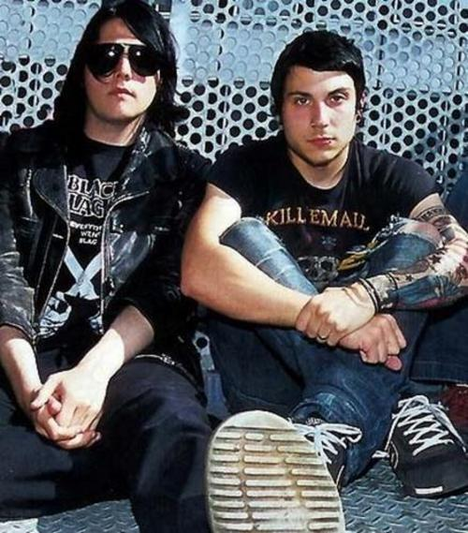
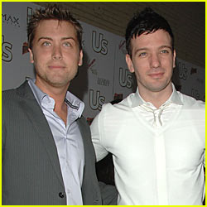
Celebrity False Identities
3/21 Harry Styles and Louis Tomlinson
3/2 Frank Lero and Gerard Way
4/12 JC Chasez and Lance Bass
Confidential Interval Documents. Not for external distribution outside of the Metropolitan Police’s Special Assessment Unit. Before sharing with non-employees obtain permission from a compliance VP and legal. Barclays requests an exemption from all Public Records Act disclosures to protect trade secrets as this slide deck is fictional.

Slide 6
Witness Statements Inconsistent
Witness reported that robbers had exotic weapons:
Tommy Gun
AR-15
“Laser Gun”
Glock
Photos from nearby security cameras are inconsistent with long guns.
Some witness report that they only had “water pistols” or finger guns.
Possible hypnotism or similar?
Confidential Interval Documents. Not for external distribution outside of the Metropolitan Police’s Special Assessment Unit. Before sharing with non-employees obtain permission from a compliance VP and legal. Barclays requests an exemption from all Public Records Act disclosures to protect trade secrets as this slide deck is fictional.

Slide 7
Internal Security
Bank Branches were hit at times of unusual levels of cash on hand.
Each branch had more than double the typical branch.
Timing was generally optimal as branch traffic was typically low mid-afternoon.
Individuals arrived shortly before armored cars came to collect excess cash.
Ongoing effort to identify possible internal suspects.

Slide 8
Targeted Branches Have High Cash On Hand
Confidential Interval Documents. Not for external distribution outside of the Metropolitan Police’s Special Assessment Unit. Before sharing with non-employees obtain permission from a compliance VP and legal. Barclays requests an exemption from all Public Records Act disclosures to protect trade secrets as this slide deck is fictional.

Slide 9
Action Plan
Objective: Identify Any Internal Leaks
John Goodheart is interviewing employees that accessed cash levels or otherwise had access at the time.
Special Assessment Unit is invited to assist with interviews.
Objective: Apprehend Perpetrators
Request the Special Assessment Unit take point on the investigation due to the characteristics of the cases.
Barclays is enthusiastic to cooperate with any investigations to avoid future incidents.
Confidential Interval Documents. Not for external distribution outside of the Metropolitan Police’s Special Assessment Unit. Before sharing with non-employees obtain permission from a compliance VP and legal. Barclays requests an exemption from all Public Records Act disclosures to protect trade secrets as this slide deck is fictional.

Slide 10
Thank You
Questions?
Confidential Interval Documents. Not for external distribution outside of the Metropolitan Police’s Special Assessment Unit. Before sharing with non-employees obtain permission from a compliance VP and legal. Barclays requests an exemption from all Public Records Act disclosures to protect trade secrets as this slide deck is fictional.

